Slide 1
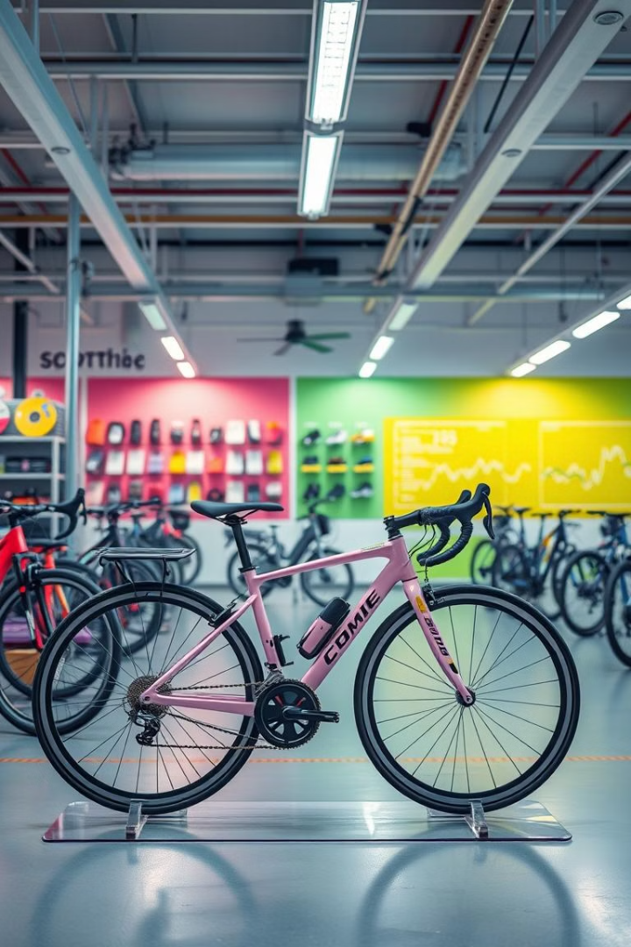
Case Study: Seasonal Profit Analysis for AdventureWorks
VA
by Vaibhav Ahuja

Slide 2

Scenario
Company
Scope
Regions
Product Categories
AdventureWorks, a sports cycle manufacturer
Analyzing seasonal sales trends
Operating across 10 regions
Accessories, Bikes, Clothing, Components

Slide 3
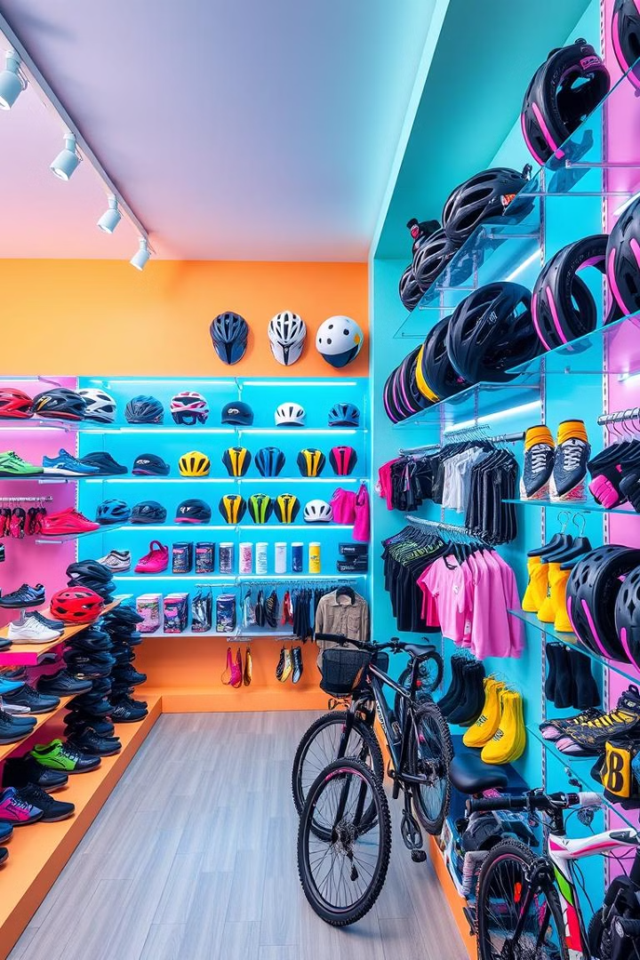
Product Category Performance
1
Consistent Profitability
2
Seasonal Fluctuations
Accessories, Clothing, and Components consistently remained profitable, showing no recorded losses.
Bikes experienced significant seasonal fluctuations, with notable losses during summer months.
3
Top Performer
Components emerged as the most profitable category, averaging ₹83K in monthly profits.

Slide 4
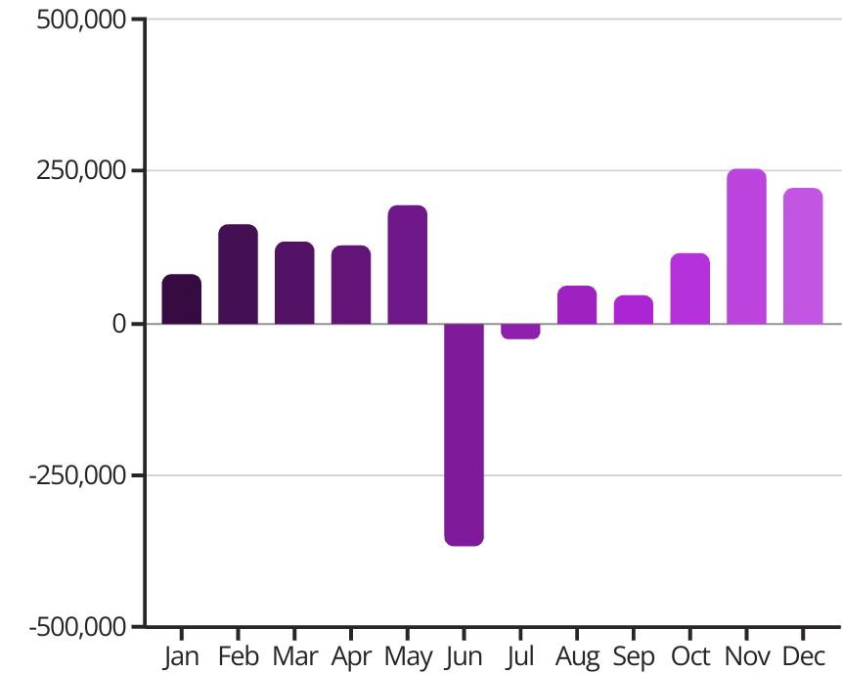
Monthly Sales & Profit Trends
June recorded the lowest sales across all product categories, with Bikes suffering the worst losses (₹448K).
August was the best-performing month for all categories except Bikes.
November and December were the most profitable months overall, each exceeding ₹200K in profit.
January to April & October showed moderate performance across all categories.

Slide 5
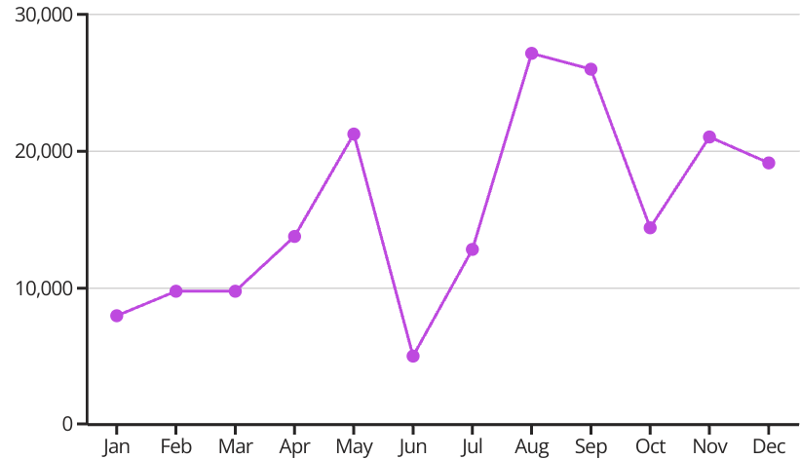
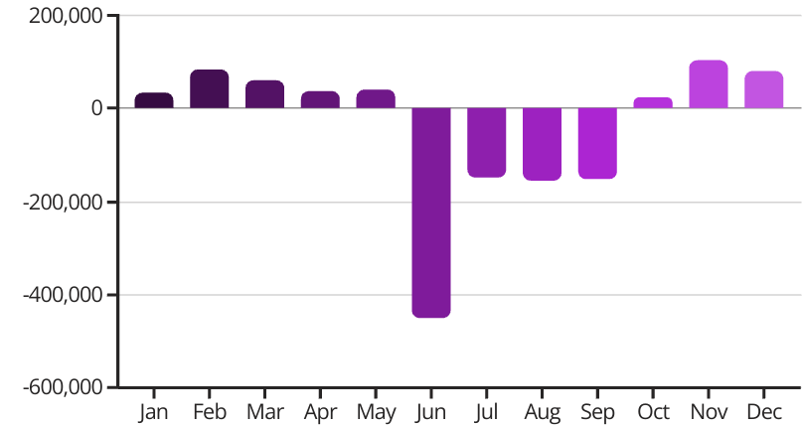
Category-Wise Seasonal Performance: Accessories & Bikes
Accessories
Bikes
Showed weaker sales in January, February, March, and June (₹5K–₹9K per month, compared to a ₹15.6K average).
Suffered major losses from June to September, worst in June (₹448K loss) and around ₹150K loss in other summer months.
Other months ranged from ₹10K to ₹25K in monthly profit.
Winter months (Feb, Mar, Nov, Dec) were the most profitable (₹80K–₹103K).

Slide 6
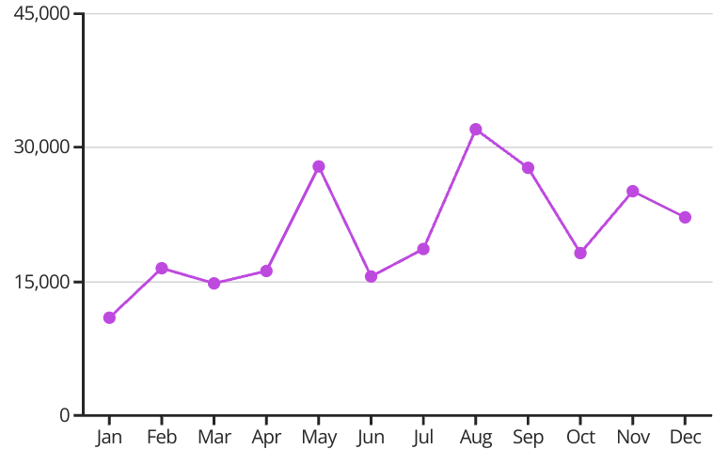
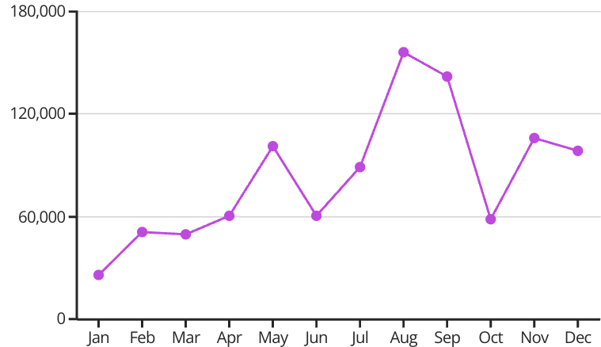
Category-Wise Seasonal Performance: Clothing & Components
Clothing
Components
Performed best from August to December and in May, averaging ₹25K profit per month.
January was the weakest month with ₹25K profit, followed by moderate growth (₹55K per month) from February to April.
August was the peak month, recording ₹32K in profits.
From May onward, performance improved significantly, reaching an average of ₹100K per month.
Worst Performance in January and moderate in others.
June and October showed moderate results (₹60K profit per month).

Slide 7





Overall Observations
Consumer Behavior
Summer Slump
People tend to buy fewer sports goods in summer, likely to avoid outdoor activities.
June consistently underperformed, showing the lowest profits across all categories (₹366K loss overall).
2
1
Seasonal Patterns
Each category has distinct peak and low seasons, but June and October remained weak across all.
3
Steady Performance
5
The first five months of the year showed steady, moderate performance across all categories.
Strong Periods
4
November and December showed strong profits, while August and September were profitable except for Bikes.

